Slide 1
MBA737A Presentation
A Case Study on Asian Paints
Presented by:-
Manish Sharma(210585)
Aryaman Singhal(200196)
Prabuddha Singh(200691)
Avni Agarwal(200235)
Prabhu Dayal(200690)

Slide 2
Contents
Asian Paints
Market Statistics
Simple Linear Regression Models
Multiple Linear Regression Models
Nonlinear Regression
Summary

Slide 3
Asian Paints
The company, a global leader in the paint industry, originated in 1942 in Mumbai, founded by four friends during World War II
In 1995, Asian Paints went public, the following year, in 1996, it became a part of Nifty 50, and in 2008, it joined the BSE Sensex.
As of May 2023, the company boasts a market capitalization exceeding ₹3 lakh crores, securing its position among the top 10 paint companies by market cap.

Slide 4

Asian Paints: A Financial overview

Slide 5
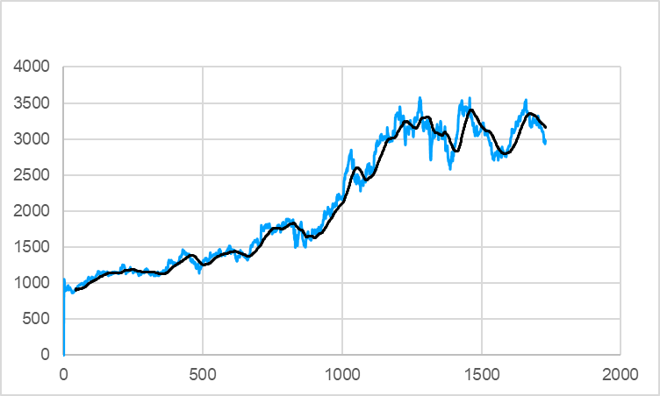
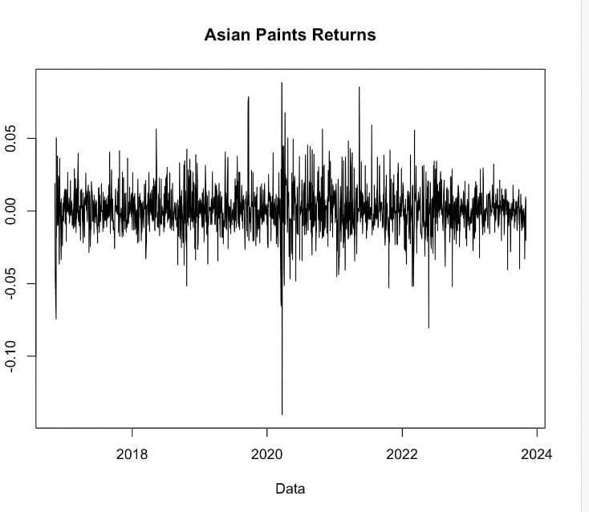
Market Data of Asian Paints

Slide 6
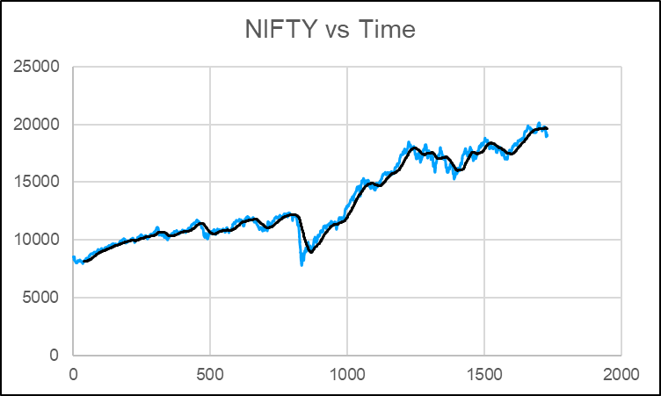
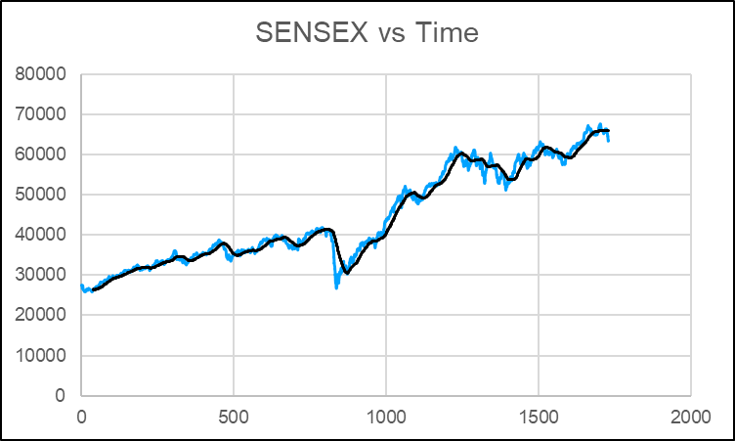
Market Data

Slide 7
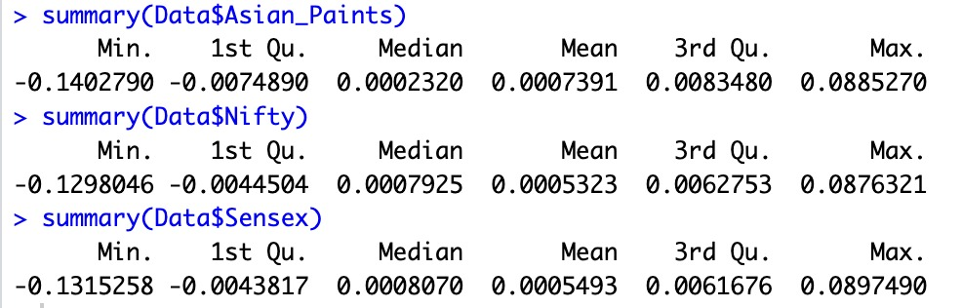
Summary Statistics

Slide 8
Interpretation of other Statistics
All the three time series become stationary when returns are calculated
Skewness tells us the direction of outliers. In a positive skew, the tail of a distribution curve is longer on the right side. This means the outliers of the distribution curve are further out towards the right and closer to the mean on the left. Skewness does not inform on the number of outliers; it only communicates the direction of outliers.
A stock with a leptokurtic distribution (kurtosis>3) generally depicts a high level of risk but the possibility of higher returns because the stock has typically demonstrated large price movements.

Slide 9
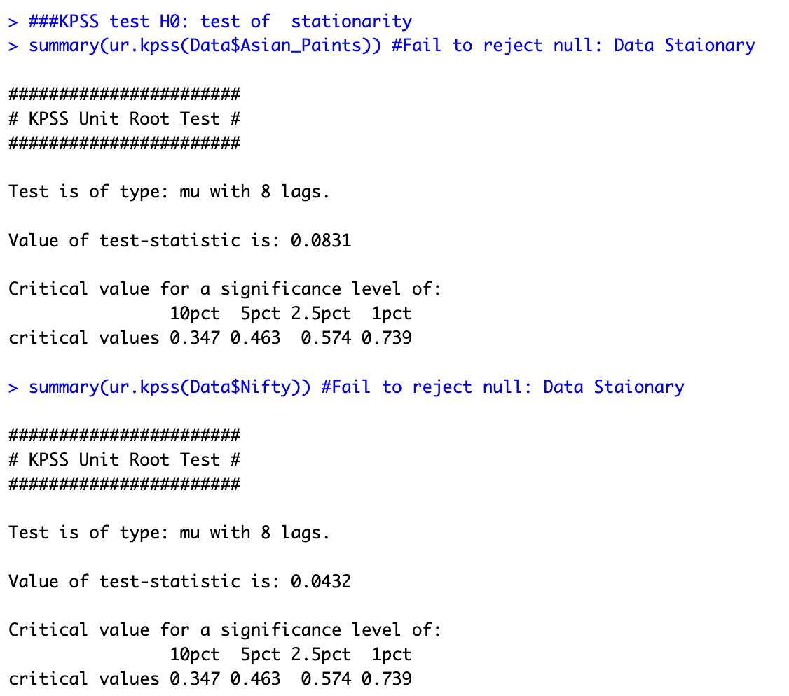
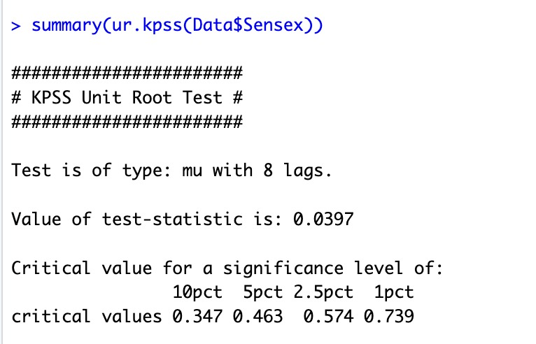
Market Statistics: Stationarity
Market Statistics: Stationarity

Slide 10
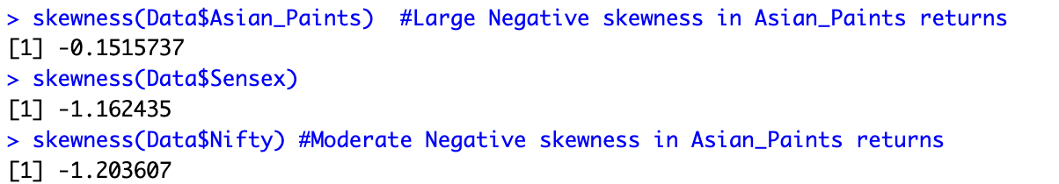
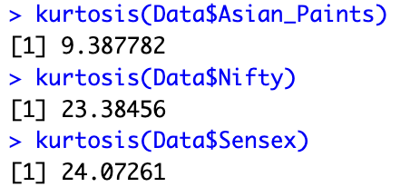
Market Statistics: Skewness & Kurtosis

Slide 11
Multicollinearity
Multicollinearity in regression analysis occurs when two or more predictor variables are highly correlated to each other, such that they do not provide unique or independent information in the regression model.
The most common way to detect multicollinearity is by using the variance inflation factor (VIF), which measures the correlation and strength of correlation between the predictor variables in a regression model.The value for VIF starts at 1 and has no upper limit. A general rule of thumb for interpreting VIFs is as follows.
A value of 1 indicates there is no correlation..
A value between 1 and 5 indicates moderate correlation.
A value greater than 5 indicates potentially severe correlation.

Slide 12
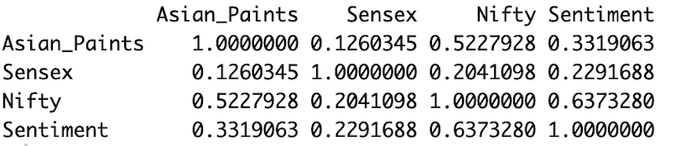
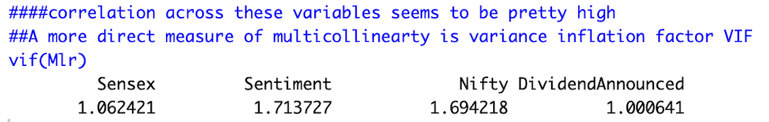
CORRELATION MATRIX(Returns)

Slide 13
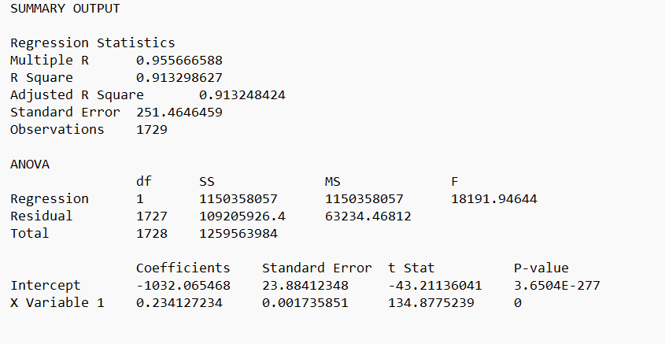
Regression Analysis: NIFTY Prices

Slide 14
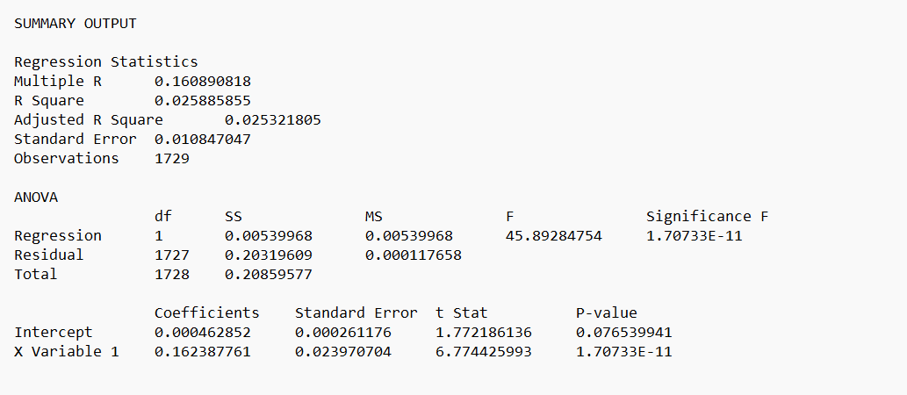
Regression Analysis: NIFTY Returns

Slide 15
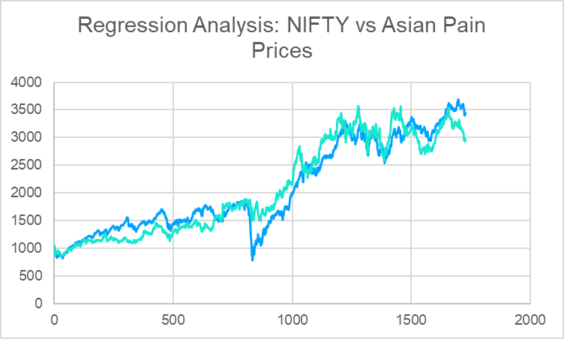
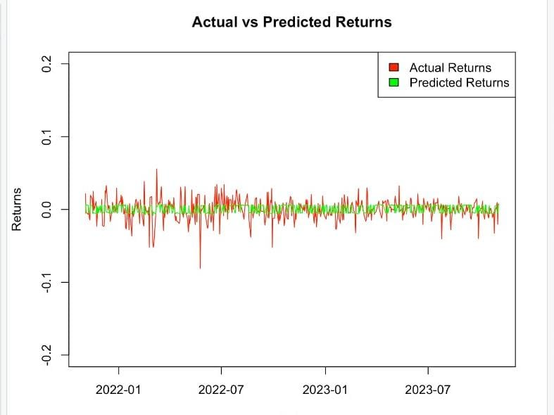
NIFTY Visual Plots: Linear Regression

Slide 16
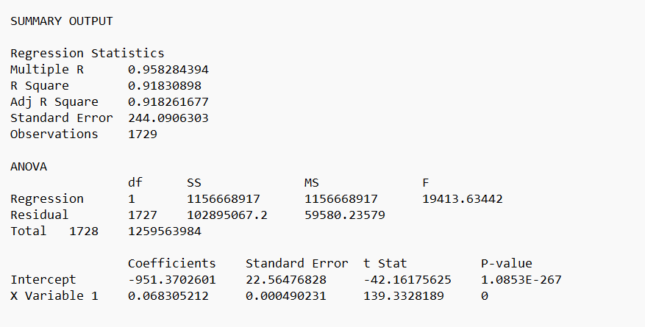
Regression Analysis: SENSEX Prices

Slide 17
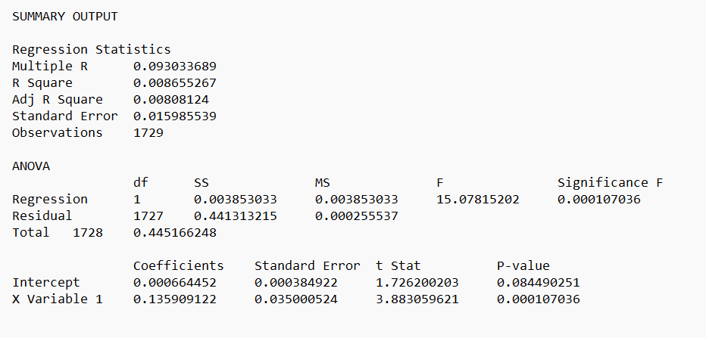
Regression Analysis: SENSEX Returns

Slide 18
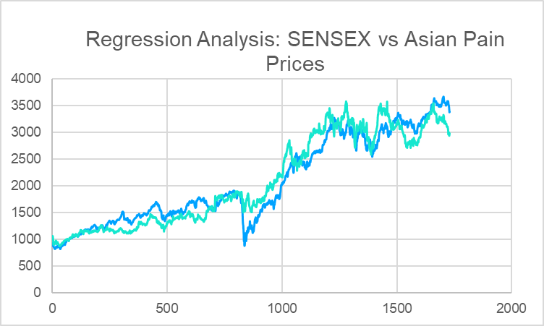
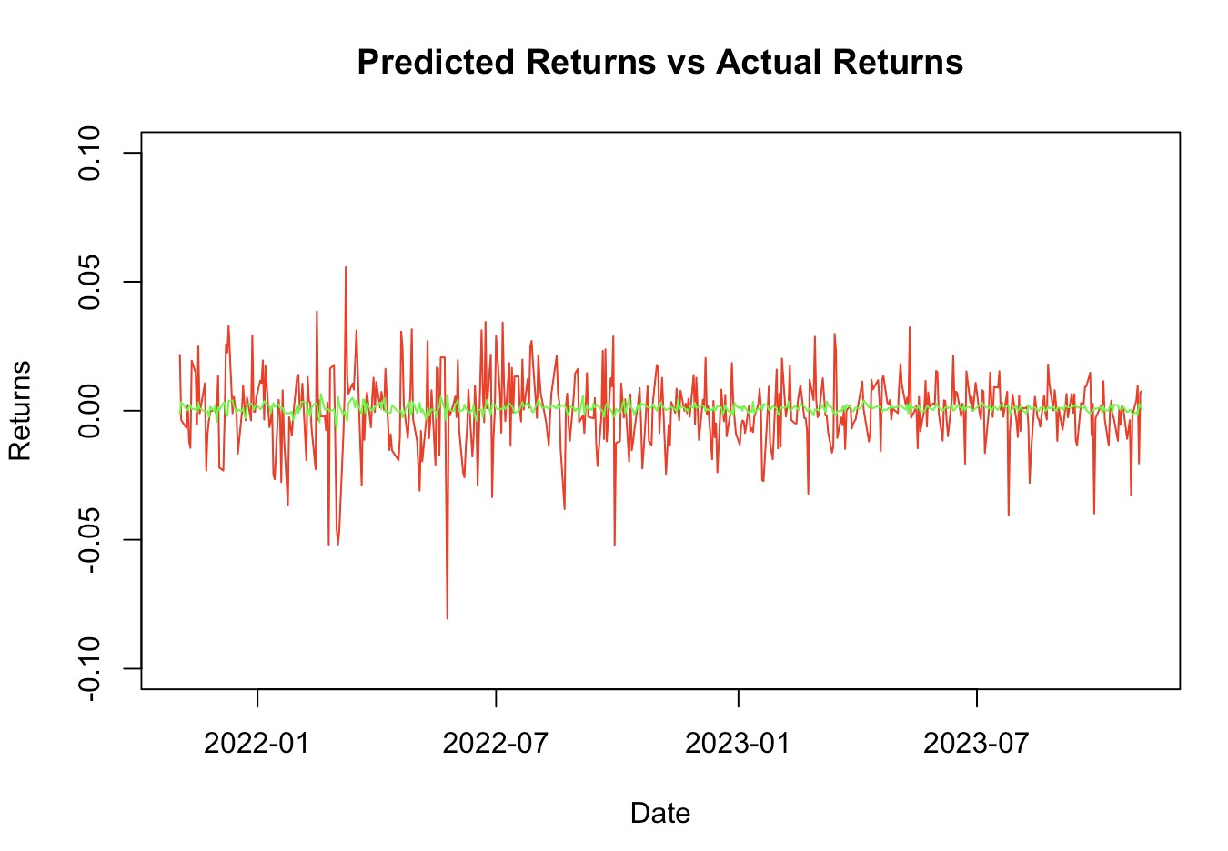
SENSEX Visual Plots: Linear Regression

Slide 19
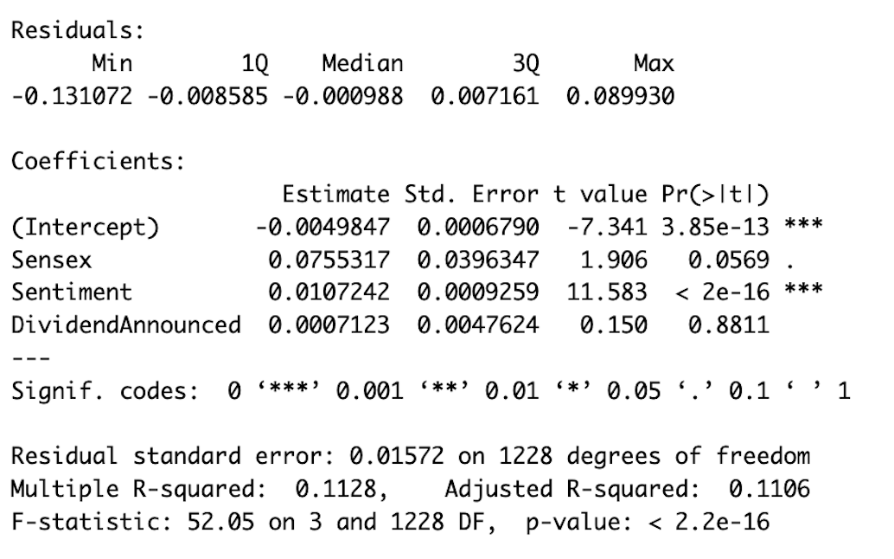
MLR: Summary(Without NIFTY)

Slide 20
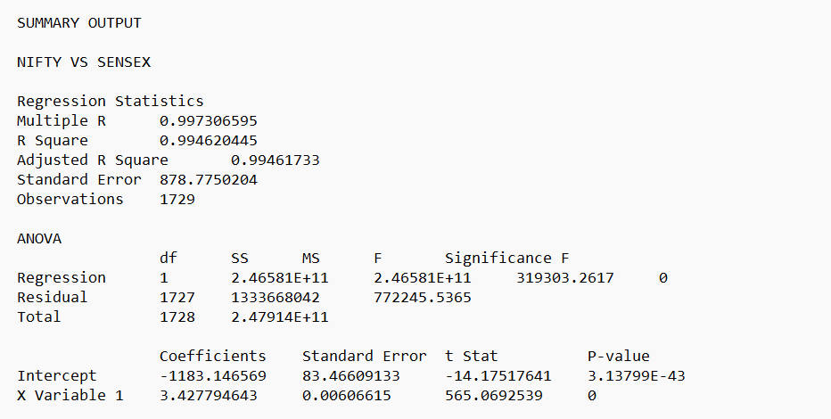
MULTICOLLINEARITY BETWEEN NIFTY AND SENSEX PRICES

Slide 21
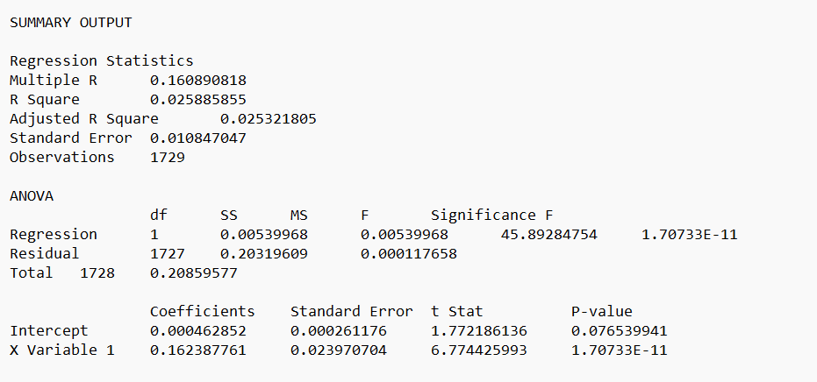
MULTICOLLINEARITY BETWEEN NIFTY AND SENSEX RETURNS

Slide 22
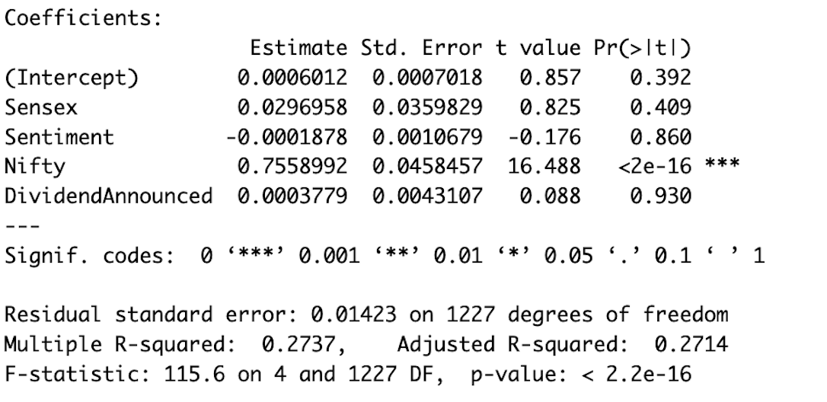
MLR: Summary(With NIFTY)
Correlation between the predicted object and actual data:0.2937028

Slide 23
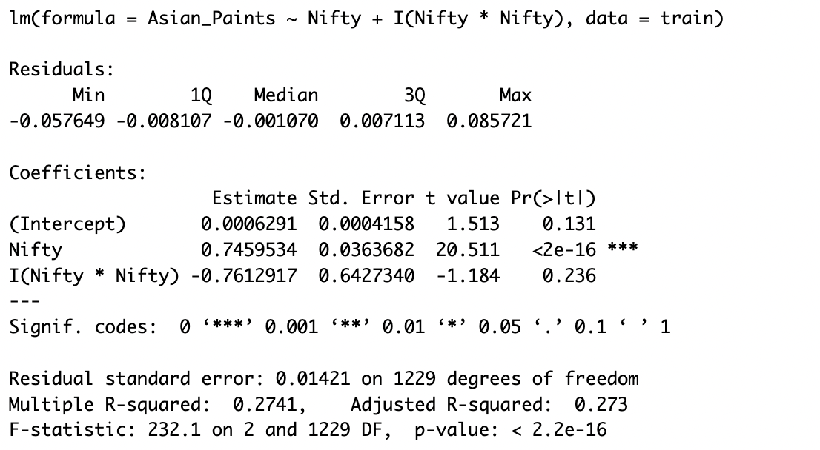
SLR2: Simple Non-Linear Regression

Slide 24
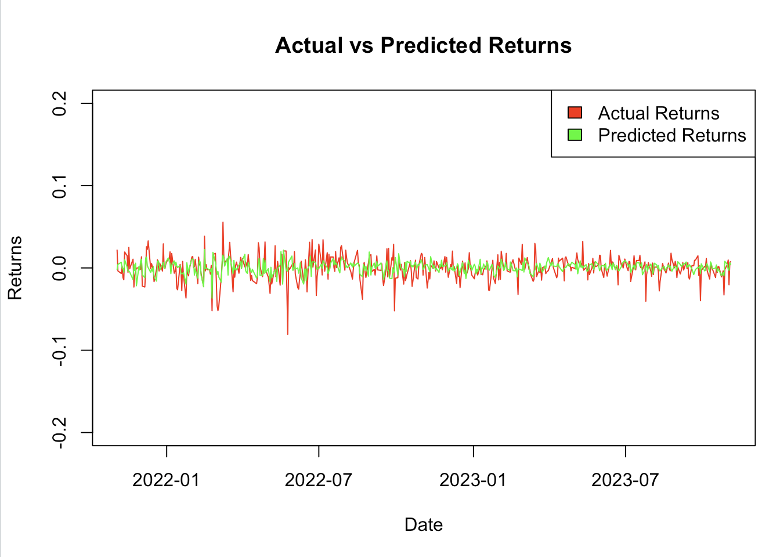
SLR2: Simple Non-Linear Regression

Slide 25
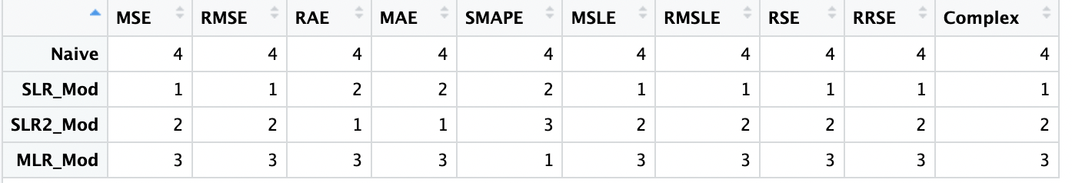
ERROR-MODEL NAME RANK MATRIX

Slide 26
Appendix: Remaining Graphs

Slide 27
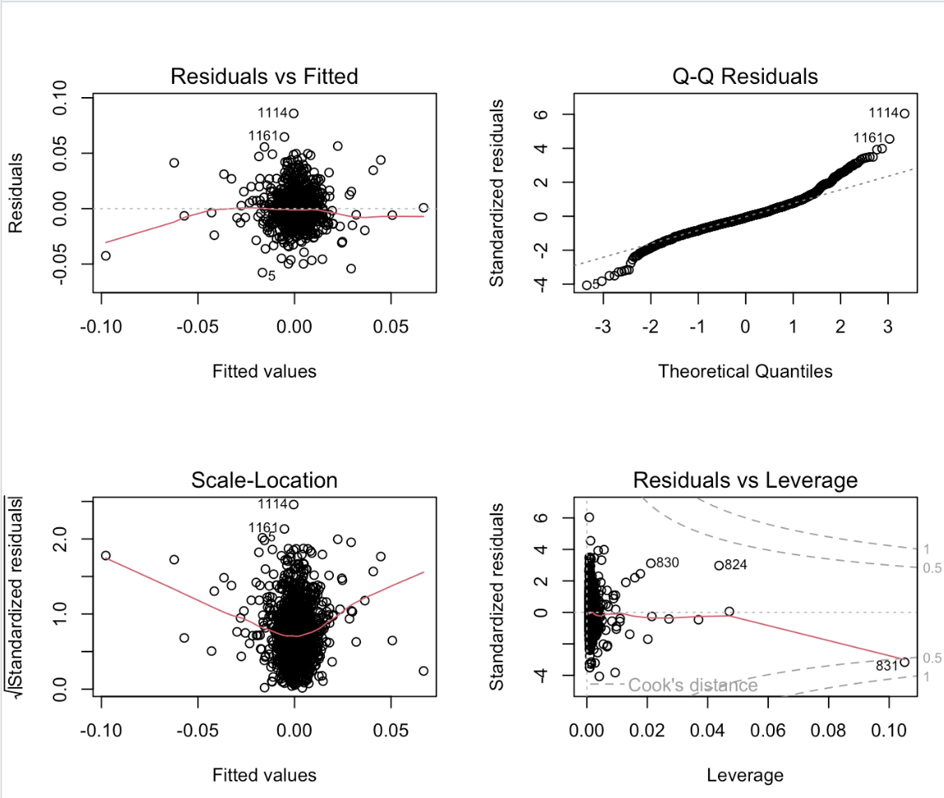

Slide 28
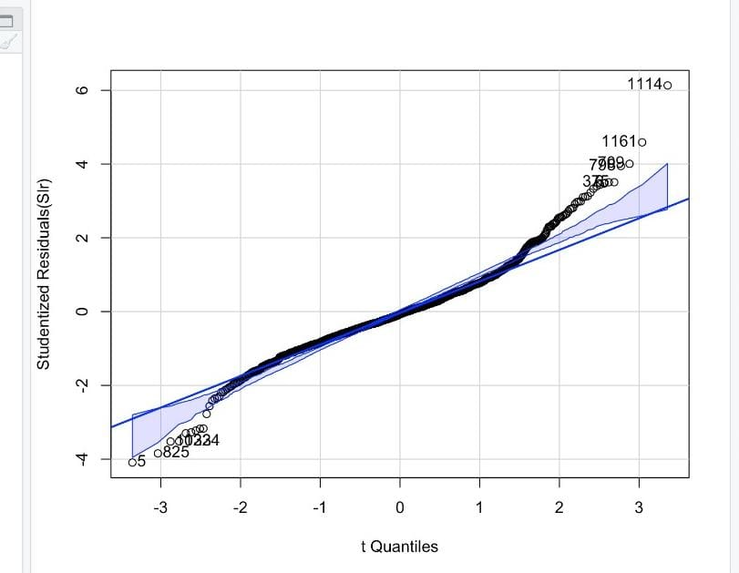

Slide 29
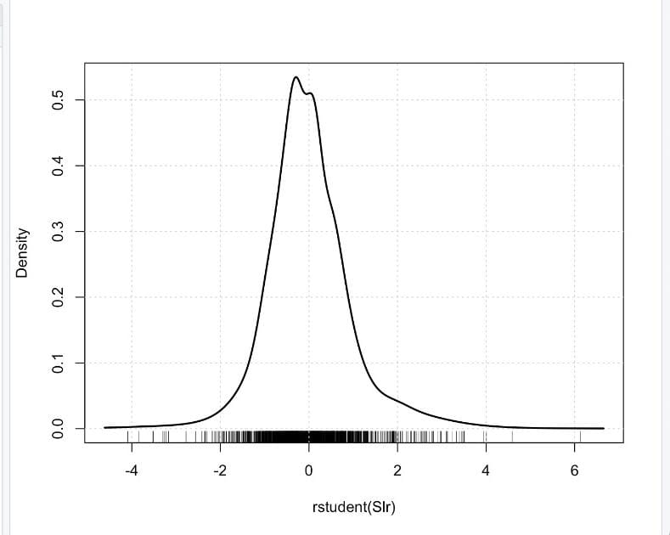
DENSITY PLOT OF RAW RESIDUALS

Slide 30
